Slide 1
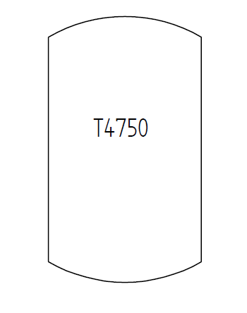
Test Case C06V01 – Tank in PlantStructure
A tank with tag name T4750
that is part of a PlantSectionIso10209-2012 with identification code „Section-1001“
that is part of a ProcessPlant with identification code „ABC Plant“
that is part of a SiteIsa95 with identification code „DEXPI Site“.
The tank is also located in a PlantTrain with identification code „Train 2“.

